Slide 1


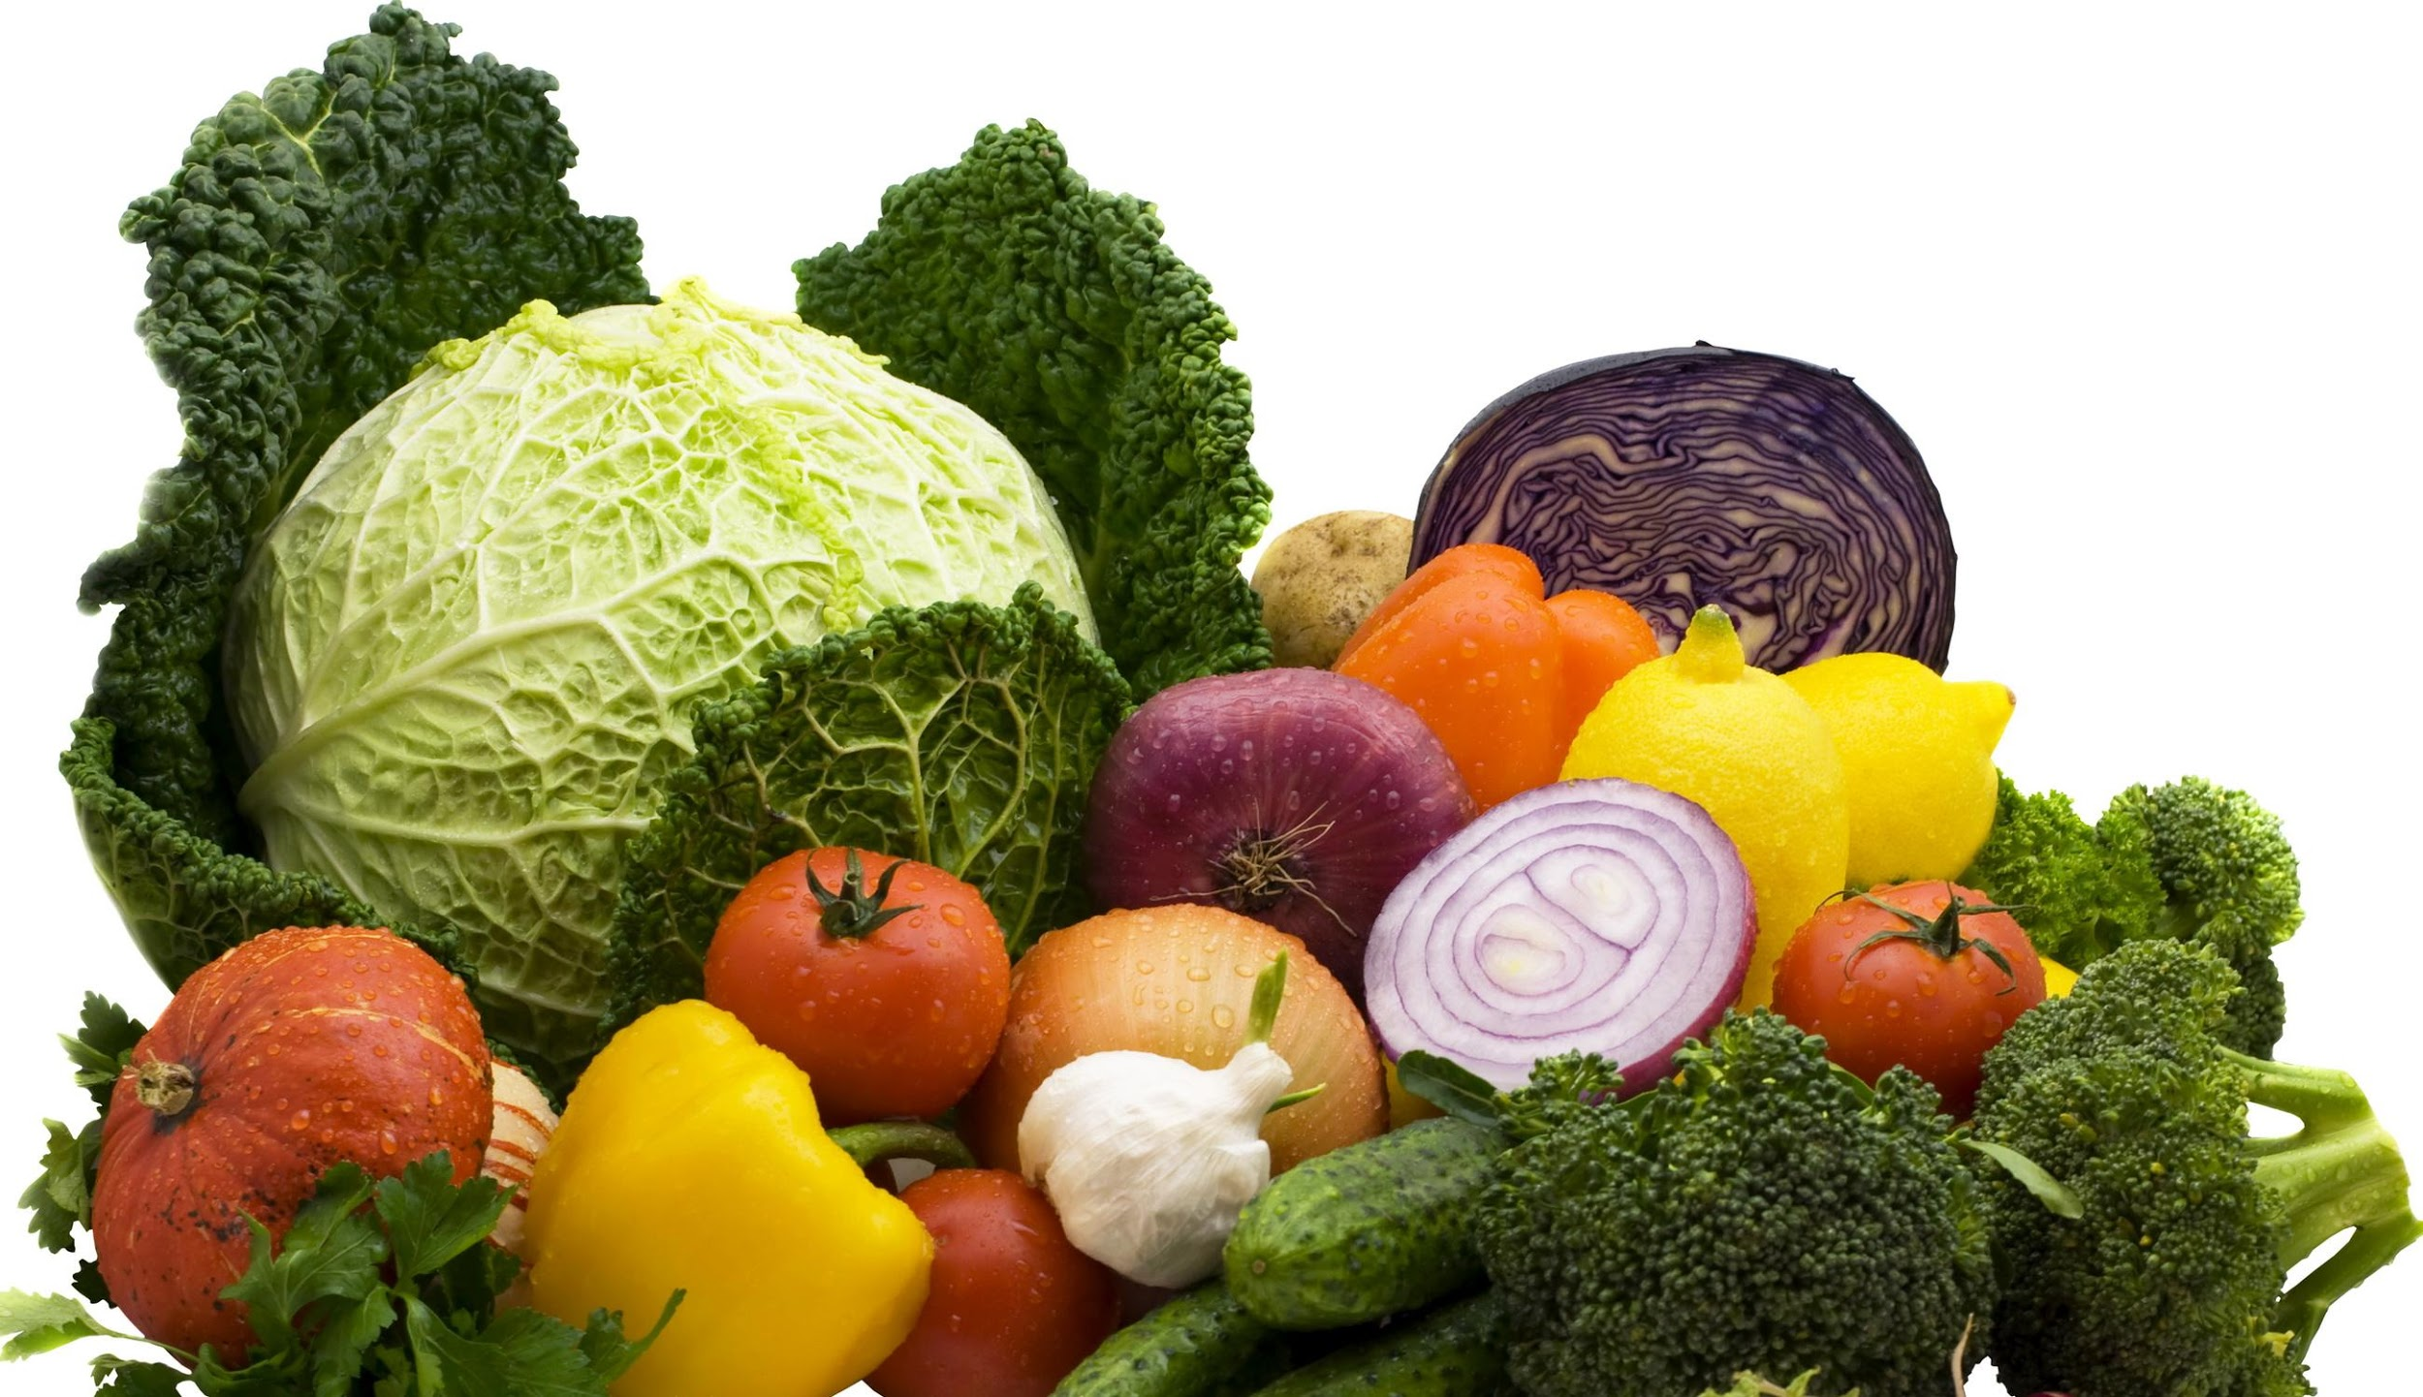
From Bagels to Beets: A Sports Nutritionist’s Journey to Real Food & Personalized Performance
Julie Burns, MS, RD, CCN
SportFuel, Inc.. and Eat Like the Pros, LLC
Notes:
1

Slide 2


We want our families and
clients to be HEALTHY & HAPPY!
© 2016 SportFuel, Inc..
Notes:
When parents are surveyed of what they want most for their children, the two most common answers are they want their children to be healthy and happy. As a parent of triplets, who are now 22?!, I know that what makes your child happy is not always makes them healthy! In this picture, we look very happy. Enjoying a high sugar breakfast of juice, fruit and bagels (a far cry from what I now consider healthy)! However, one of my kiddos had a laundry list of health issues that initiated my quest to find a more holistic and natural way to help my child (and entire family) be both healthy and happy!
HEALTHY AND HAPPY WOMEN = HAPPY AND HEALTHY CHILDREN, SPOUSES, HOME

Slide 3
Let’s talk about…
Athletes’ wishes
Sources of stress
Building an evolutionary foundational diet
Macros for athletes
Functional assessment and basic testing to personalize
Food science & clients’ wish list
Resources
© 2016 SportFuel, Inc.
Notes:
Before an athlete is a high performance machine – he/she is first HUMAN – foundation has to be set

Slide 4

Athlete’s Wish List
Maximize performance
Make best food and beverage choices
Increase energy
Maintain strong focus
Reach best playing weight/body composition
Recover more quickly
Promote healing
Prevent illness
Correct GI disturbances
Sleep better
Extend career
Determine appropriate supplementation
© 2016 SportFuel, Inc.
Notes:
4
Proper diet /lifestyle can make a good athlete → GREAT
Athletes look like their parents on paper, they appear healthy, but the demands of a professional sport take a toll on the body #stress

Slide 5
Sources of Stress
*Infections and Dysbiosis
Poor Diet (refined, GMO, pesticide, artificial)
Relationships
Environmental/pollution
Excessive ETOH
Heavy metals
Cleaning products
Mold
Skincare products
Sleep deprivation
Work
Commuting
Appropriate activity level
Medications/Antibiotics
Eating on the fly
Family history
Finances
Technology
© 2016 SportFuel, Inc.
Notes:
For athlete and non-athlete alike
BPA: perinatal (immediately before and after birth) exposure to BPA altered oral tolerance and immunization to dietary antigens (OVA). In summary the naïve immune system of neonate is vulnerable to low doses of BPA that trigger food intolerances later in life.
Meds include birth control, NSAIDS, statins, abx, etc.
Adrenals are often taxed because of the gut imbalances

Slide 6

Modulate Stress
Evolutionary diet as template to start
Get at least 7.5 hours of sleep
Meal-time habits
Sit, chew, swallow
Tech-free meals
Restorative exercise
Yoga or Tai Chi
Meditation & gratitude
Massage & acupuncture
Music, Nucalm
Nature
Wise use of technology
Headspace
F.lux app
Notes:
Digestion needs restful environment:
The smaller the protein particles, the lower risk for immunoreactivity
Chewing allows igA to bind, Salivary glands also produce immune substances that help us fight microorganisms we are exposed to so adequate chewing of food is so important for digestive health

Slide 7
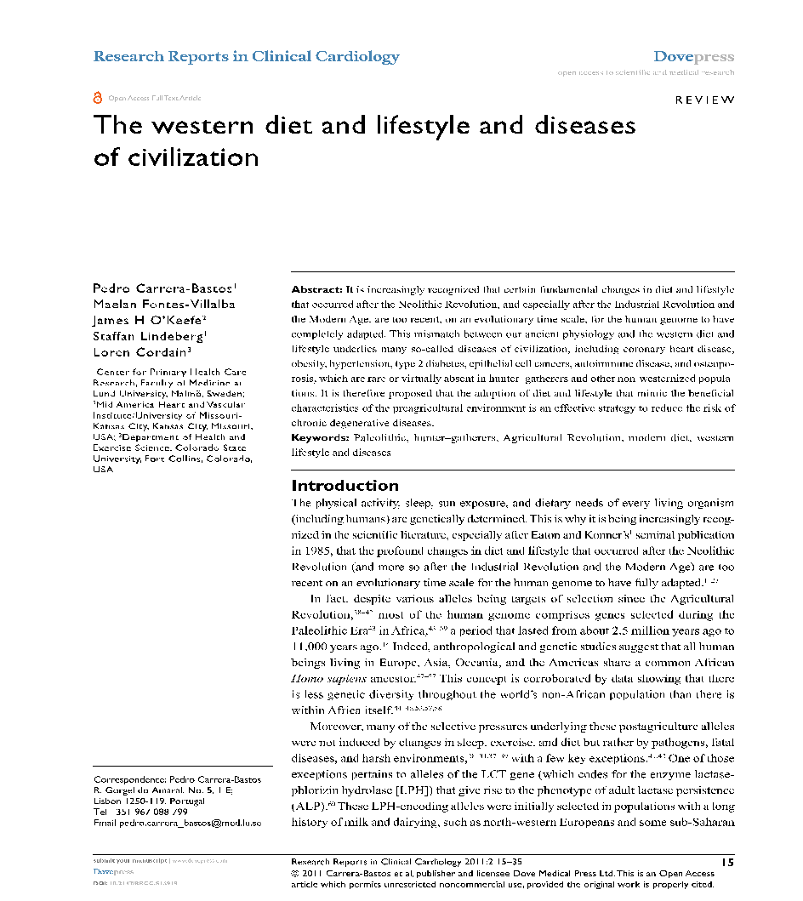
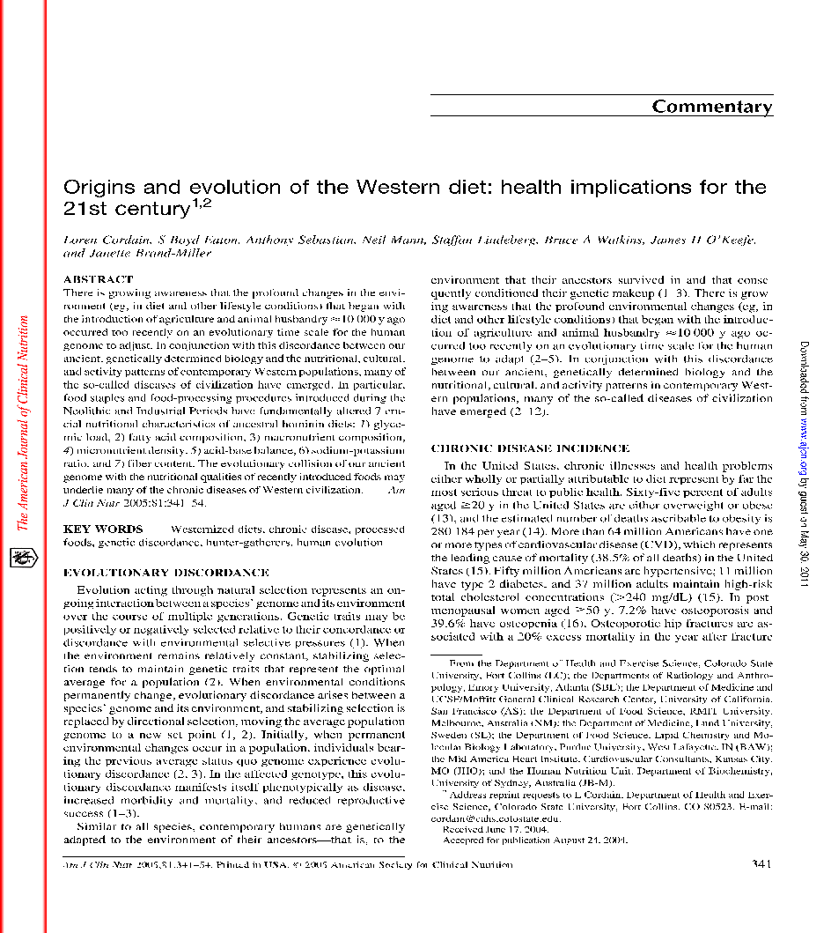
Get Back to Our Roots
© 2016 SportFuel, Inc.
Notes:
These two papers are interesting reads.
The Western Diet and Lifestyle and Diseases of Civilization, Cordain et. Al
Origins and Evolution of the Western Diet; Health Implications for the 21st Century
Certain fundamental changes on diet and lifestyle after neolithic nut esp IR and Modern Age are too recent in an evol scale for the human gem one to have completely adapted. Mismatch of ancient physiology and western diet and lifestyle may underlie many so called dsi of civilization.
Ind reached 68-78 years without signs of symptoms of chronic dz like many elderly
I encourage you to read these articles

Slide 8
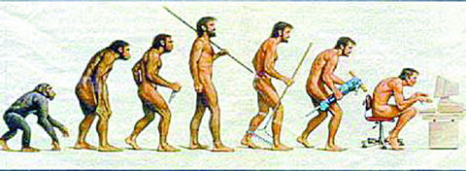
Food for Thought
How has diet changed in last 100 years?
Societies have thrived on different diets for centuries
Weston A. Price Foundation
Customized nutrition for each person and his/her unique needs
© 2016 SportFuel, Inc.
Notes:
Our food supply is changing. The way we grow food, store it, cook it (microwaves), and eat foods (in front of computers/while driving), has changed significantly in last 100 years! Societies with fewer chronic illnesses, typically consume a diet that resembles how their ancestors ate.
Do you eat how your great grandparents ate? Mostly likely not! We have a heavy reliance on convenience and fast foods.
The ‘Paleo’ diet has gained a lot of popularity and attention in the last decade. Do diets need to be this ‘restrictive’? is there a middle ground that enables clients to combine healthy eating and modern conveniences?

Slide 9
US Dietary Intake
Sugar and Refined Carbohydrates
152 Pounds of sugar per person per year!
Omega 6:3 Ratio
10:1 Ratio
Servings of non-starchy vegetables
< 1 cup of vegetables per day
Sodium Potassium Ratio
1.5 : 1
Fiber Intake
15g per day
© 2016 SportFuel, Inc.
Notes:
These findings were published in Origins of the Western Diet paper.
The American diet is incredibly different than the ‘evolutionary’ diet.
Sugar: The greatest source of fructose came from wild berries (a very seasonal treat)
Omega 6:3 ratio: Was more 2:1; Industrial oils and lack of omega 3’s in the American diet combined with little to no sea vegetables
Non-Starchy veggies: It’s estimated that Americans eat around 1 cup of veggies per day; compared to 8 to 10 cups our ancestors most likely consumed (shrubs, grasses)

Slide 10

SportFuel's Foundational Diet
Customized for each client
No “one-size fits all” approach
Combines cutting edge science with common sense
Simple but not always easy
© 2016 SportFuel, Inc.

Slide 11
Premium Fuel, as Nature Intended!
Eat foods that will rot and spoil, but eat them before they do!
Eat foods as close to their natural state as possible
Eat a variety of whole foods
Real food begets real results
Pastured eggs with yolk rather than Egg Beaters
Maple syrup or raw honey rather than artificial sweeteners
Butter rather than margarine
Grass-fed meats rather than processed soy protein
© 2016 SportFuel, Inc.
Notes:
When food coloring is bound to proteins in your food, it GREATLY reduces the digestibility, which can lead to extensive problems in the digestive tract.

Slide 12
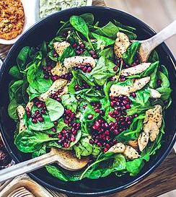
Eat Nature’s Colors!
Fill half the plate with non-starchy veggies
50% Raw
50% Cooked
Include healthy fats to maximize absorption
Eat fresh berries for dessert
Aim for 3 colors at each meal
© 2016 SportFuel, Inc.

Slide 13
VEG UP!
Aim for 6 handfuls of veggies per day
Add greens to smoothies
Powdered greens
Try fresh pressed juices
Add spinach, tomato, and cucumbers to sandwiches/wraps
Bulk up breakfast with veggies & eggs
End dinner with greens tossed in vinegar and EVOO
Spiralize squash for a pasta alternative
Location is everything!Place veggies in convenient location
© 2016 SportFuel, Inc.
Notes:
13
It’s easy as practitioners to tell clients to eat their veggies, here are some practical ways to make it happen!

Slide 14
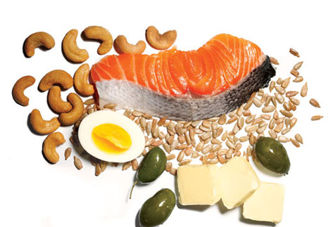
Include Healing Fats
Wild cold water fish (salmon)
Grass-fed/finished meats
Butter, Ghee, Lard, Tallow
Avocado
Chia seeds or ground flax
Sprouted nuts and seeds
Unrefined coconut oil or MCT oil
Raw pumpkin seed, poppy seed & olive oils
Unrefined, cold-pressed, dark bottle, refrigerate
Clean EFA supplement
© 2016 SportFuel, Inc.
Notes:
Upwards of 50%+ for some of daily calories but varies quite a bit based on activity, insulin resistance, etc. No one size fits all!

Slide 15

Opt for Clean Protein
You are what you eat…
100% Grass-fed and finished beef
Pasture-raised eggs, turkey and chicken (skin on if organic)
Cold water wild fish (salmon)
Full-fat organic cultured dairy, if tolerated
Sprouted nuts and seeds
AND what your food ate…
© 2016 SportFuel, Inc.
Notes:
Quick review of protein:
Building block for muscles/skin/bone etc.
Basic unit of our DNA consist of protein
Provides satiety and appetite control
Your body isn’t able to use protein for muscles if you aren’t eating enough overall – it is concerned with your basic functions like building DNA and detoxification
What are clean proteins? Clean proteins are ‘clean’ of antibiotics, hormones and animals free of disease.

Slide 16
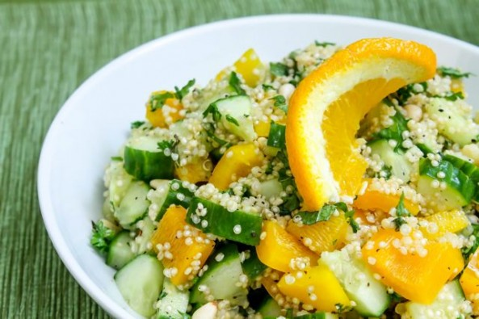

Select Whole Food Carbohydrates
Gluten Free Grains
Wild Rice
Amaranth
Buckwheat
Millet
Certified Gluten Free Oats
Quinoa
Teff
Starchy Veggies and Fruit
Winter Squash (acorn, butternut)
White Potatoes
Sweet Potatoes
Yams
Spaghetti Squash (lower carb)
Beets, Berries & Fresh Juices
© 2016 SportFuel, Inc.
Notes:
Carbs are the spark to the fire, and fat is the log to keep it burning

Slide 17


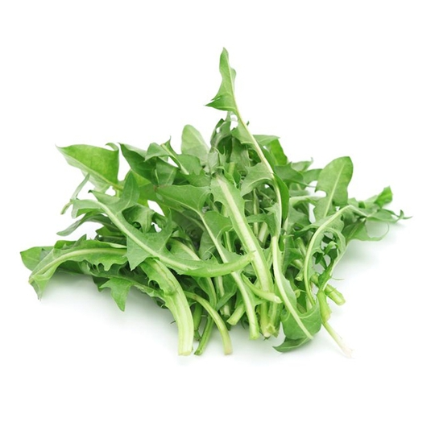
Extra Special Starch
Resistant Starch (IF that feeds!)
Cooked then cooled potatoes, rice, legumes
Unmodified potato starch
(add anywhere)
Unripe banana/plantain
(smoothie)
Uncooked rolled oats
(overnight oatmeal)
Generation UCAN
(training)
NStarch Polysach.
Inulin/FOS, larch arab., galactooligo, beta glucan
Fermentable Fibers (Favor Soluble over Insoluble fiber veggies)
Chicory root
Jerusalem artichoke
Yams, Sweet Potato, Potato
Carrots
Plantain, Taro, Yuca
Onion
Garlic
Fruits with edible peels
Soluble fibers extracts: PHGG, glucomannon, psyllium, acaica, MCP
Fermenting insoluble veggies
Cooked vs. raw
© 2016 SportFuel, Inc.
Notes:
RS appears to increase butyrate production more when compared with other soluble fibers
Bob’s red mill has 8g RS in 1 Tbsp. – usually tolerated well even by those who don’t tolerate nightshades – I’d favor this over UCAN as it is more REAL FOOD than UCAN.

Slide 18

Drink PURE WATER
Dehydration can lead to:
Constipation
Acne
Dry/itchy skin
Headache
Tiredness
Recurrent infections
Loss of energy
Body weight in pounds / 2 = minimum oz. of plain water you should drink every day!
© 2016 SportFuel, Inc.
Notes:
Water is needed for daily detoxification and immunity, and thirst is often mistaken for hunger so be sure to always stay hydrated and keep your kids hydrated
Always add unrefined sea salt to food

Slide 19
Foundational Diet for Athletes
Multiply current weight in pounds by 12 to 14 to get baseline for calories
Add 100 calories for every 10 minutes of moderate to high intensity
For fat loss, do not exceed more than 20% calorie deficit
© 2016 SportFuel, Inc.

Slide 20
Macros for Athletes
Protein
Aim for 25 to 35% of calories from protein
0.8 to 1.4 grams of protein per pound of body weight
Carbohydrates
Needs depend on type of sport and personal preference
High-intensity sports benefit from higher carb intake
40 to 50% of calories, but exceptions
Endurance sports may benefit from lower carb intake
7 to 20% of calories
Majority of athletes will do best between 20 and 50% of calories from carbohydrates
Photo deleted.
© 2016 SportFuel, Inc.
Notes:
Picture: roasted chicken; an example of a high quality protein

Slide 21
Fat and Hydration for Athletes
Fat
Determine protein and carbohydrate needs first
Remainder of calories should come from healthy fats
Water and Electrolytes
Drink 2L of water daily
Add an extra 500mL per hour of vigorous activity
Drink 16 oz (2 cups) of water for every pound lost during training/athletic event
Weigh before/after
Salt all food liberally (to taste)
Add salt and electrolytes to beverages if exercising more than 1 to 2 hours
© 2016 SportFuel, Inc.
Notes:
*Maybe share story about goalie that had hypoglycemia and needed higher fat/lower carb diet? EDDIE BELFOUR

Slide 22
Going Beyond the Food Record
Analyze health history
Review health habits and sources of stress
Perform physical nutrition assessment
Cook with clients
Test, don’t guess!
© 2016 SportFuel, Inc.
Notes:
The field of nutrition is evolving! It’s no longer just about “calories in/ calories out”. Integrative nutritionists/dietitians look beyond the food record to get a holistic view of what’s causing distress for their clients. It’s important to look at a detailed health history (some questions may go back to early childhood- such as chronic ear infections (might be a dairy issue)). We also look at sources of stress (work, environmental, relationships etc). We perform a detailed physical nutrition assessment (nail beds, eyes, tongue, skin etc), and we now have some excellent clinical tools to test for food sensitivities, microflora/digestive health.
Cook with your clients! It’s an important part of compliance is showing people how to prepare healthful foods.
Note: will review these following slides

Slide 23
Signs of Food Sensitivities
Signs of potential food sensitivity:
Bloating, gas, constipation/diarrhea, upset stomach, nausea
Getting sick (cold, flu, sinus infections, sore throat)
Pain or stiffness in joints
Autoimmunity
Headaches/migraines
Brain fog or memory problems
Depression or feeling moody
Anxiety
Feeling more tired than usual
Trouble sleeping
Heart palpitations – especially when eating
Thyroid problems
Acne, eczema
Asthma
© 2016 SportFuel, Inc.
Notes:
Many times we can’t hear till we remove something from our diet
80% of our population may have some degree of gluten sensitivity
Many times we are unaware → go gf for 6 weeks → gut has time to heal and our bodies are more capable of mounting immune response against it

Slide 24
Assess for Fat Deficiency or Imbalance
Ask the following questions:
Tired?
Frequently hungry?
Craving sweets and/or convenience foods?
Weak immune system?
Having a hard time concentrating?
Experiencing dry or flaky skin, hair or nails?
Having sleep problems?
Getting injured or not healing well?
Hormonally imbalanced?
Feeling depressed or anxious?
© 2016 SportFuel, Inc.
Notes:
Many athletes show signs of EFA deficiency with a hard time regulating blood sugar and energy.

Slide 25
Gut Health
An altered gut MICROBIOME & METABOLOME are implicated in just about EVERY CHRONIC inflammatory condition.
Acne
Abx-associated diarrhea
Anxiety
Asthma/allergies
Autism spectrum disorders
Autoimmune disease
Cancer
Dementia
Dental cavities
Depression
Diabetes
Eczema
Fibromyalgia
Gastric ulcers
Heart disease
Inflammatory bowel disease
Neurological disorders
Parkinson’s disease
Many more…
© 2016 SportFuel, Inc.
Notes:
Talk about the important of gut health – infection, metabolism, brain, sleep, immunity, etc.
Microbiome=Microbiota plus their genetic material & Metabolome = Microbiome plus it’s collective metabolites. Glycobiome: Bacteria and mucus at the epithelial interface-clove study help with mucin .

Slide 26
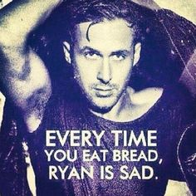
Food Shaming
Focus on what people can eat
Use positive language
Try…
Opt for…
Choose…
Identify and minimize shaming words
Avoid
Never
Disgusting/gross/junk
Model grace and patience
© 2016 SportFuel, Inc.
Notes:
Before we dive into elimination diets, it’s important to practice grace and gentleness with clients. Food is more than just calories, for some people it’s a source of joy, comfort, addiction and/or shame. Although this picture is funny, it’s important not to shame clients into eating (or not eating) certain foods. As we discuss elimination diets, they are strict and compliance can be very difficult.

Slide 27
Food Elimination Challenge
What Is It?
When It should be used:
Strict adherence to a low-allergen diet
Short term
3 weeks to 2 months
Sometimes longer
Slow re-introduction of foods every 3 days
Journal symptoms
Stagnant or minimal improvements on Foundational Diet
Autoimmune Disease
Inexpensive alternative to food sensitivity testing
© 2016 SportFuel, Inc.
Notes:
5 minutes - A true sensitivity means that any little bit of the substance can restart the entire inflammatory process, and it only takes 5 minutes for leaky gut to occur when you eat a substance you are “intolerant” to.
Food/feeling log includes what they ate, when, what time they worked out, how much energy they have through the day, how they sleep, mood, focus, digestive upset, poops, etc.

Slide 28
Food Elimination Challenge
Eat These:
Challenge these Foods:
Poultry
Fish
Eggs
Organ Meats
Bone Broth
Veggies
Healthy Fats
Avocados and olive
Fermented Foods
Fresh herbs and sea salt
Low glycemic fruits
Dairy
Grains
Legumes
Shelffish
All sweeteners
Industrial seed oils
Corn, canola, safflower, soybean
Diet sodas
Alcohol
Source: ChrisKresser.com
© 2016 SportFuel, Inc.
Notes:
Yams, sweet potatoes, yucca/manioc, taro, lotus root, beets, winter squash, etc.
Coffee and black tea are underlined if they have a caffeine issue – if they NEED it, you take it away.
No shellfish if skin issues – tropomyosin looks just like epithelial cells
Stop scratching story – let me tell you!

Slide 29
TEST.
Don’t
Guess

Slide 30
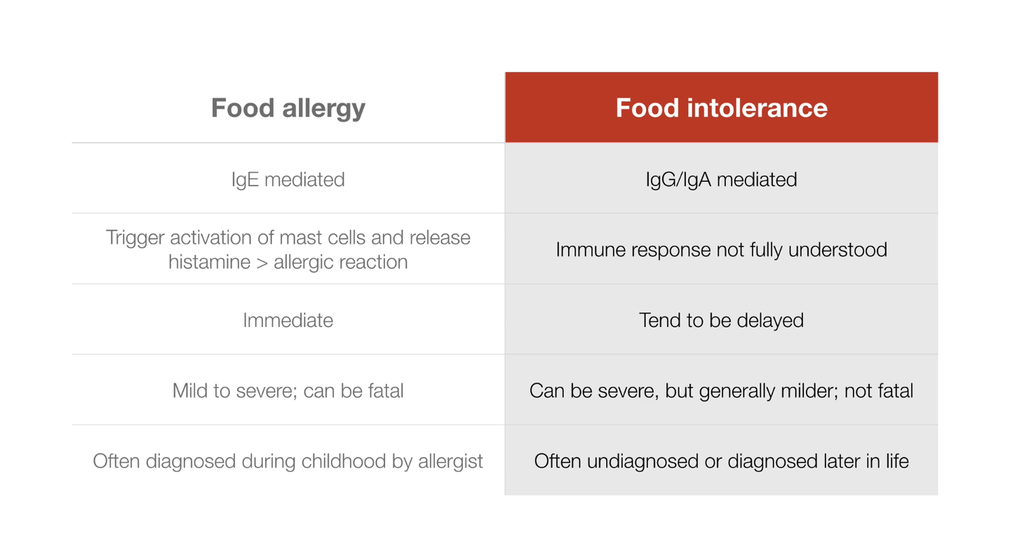
Cyrex – Antibodies for Food Sensitivities
Source:ChrisKresser.com
© 2016 SportFuel, Inc.
Notes:
Some people need convincing

Slide 31
Cyrex Labs – Antibodies for Food Sensitivities
Gluten intolerance and celiac are both related to many diseases including:
T2DM
Depression
Dermatitis herpetiformis
Osteoporosis
Heart failure
ADHD
Arthritis
Migraine
AI thyroid
Allergies
Asthma
Obesity
Up to 40% of people with ataxia and 25% of people with schizophrenia present with gluten antibodies.
© 2016 SportFuel, Inc.
Notes:
Gluten consumption when intolerant can affect nearly every cell in the body.

Slide 32
Cyrex – Antibodies for Food Sensitivities
Array 3 – Wheat/Gluten Proteome Reactivity and AI
IgG/IgA of ALL of the wheat and glutens!
Array 4 – Gluten-associated Cross-Reactive Foods
Gluten-containing, gluten-free grains, over-consumed gf foods, soy, dairy, coffee, egg, yeast, and more
Array 10 – 180 foods & ingredients, cooked/raw
Others (usually for AI)
Intestinal permeability (zonulin, LPS, actomyosin)
Multiple Autoimmune
Chemical Immune
© 2016 SportFuel, Inc.
Notes:
Can’t do if client is already gluten free, although they may still show up with antibodies from restaurants, shampoos, kissArray 3 - $325
Array 4 - $225
Array 10 – never get alone, pair with 3 and 4 for $1030 (or now till the end of March $750)
Array 4 cross-reactors: Sorghum, millet, hemp, amaranth, quinoa, tapioca, teff, soy, potato, sesame, buckwheat, egg, corn, rice, yeast, oats, whey, milk, chocolate milk, casein, rye, barley, spelt

Slide 33

Stool Testing
Looks at composition of gut flora, pathogens, yeast, parasites, fungi, absorption, inflammation, immune status and overall health
Doctor’s Data Comprehensive Stool Analysis w/Parasitology x3
BioHealth H.pylori
Stomach/duodenal ulcers
Increased risk of gastric cancer
Order alongside DD full panel
© 2016 SportFuel, Inc.
Notes:
H.pylori - associated with stomach and duodenal ulcers, and can increase risk of gastric cancer (#2 most lethal cancer)
Fungi secrete damaging toxins, promote inflammation, compete for adhesion sites, can puncture gut lining and little known effect esp with candida, there are 30% of species that secrete substances with SigA protease activity (can break down sigA to disrupt gut immune defense and people will have lower sigA with fungal overgrowth).
Yeast/fungi can have patchy distribution in stool

Slide 34
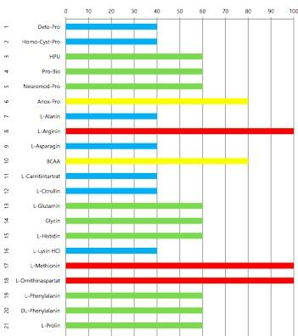


Vital Substances Hair Test
Notes:
Using advanced German technology available in the US only through SportFuel, Inc..., your specific nutritional health status is determined. Through this testing, we’ll identify the optimal amounts of various substances natural to the body that you need to achieve balance, wellness and vitality. Pricing includes the test and results for 30 analytes (amino acids, vitamins, minerals, fatty acids, balance of good bacteria, toxins, and more). SportFuel support available to help address imbalances and achieve goals.

Slide 35
Food Science: A Wish List
Sauces and Condiments
Made with extra virgin olive oil
Made with natural sweeteners such as maple syrup or honey
Contain natural sea salt
Fermented foods
Offer a variety of interesting flavors and textures
Packaged in glass, not cans
More dairy-free options
Sourdough starters
Gluten-free products
Contain a variety of ancient grains (buckwheat, millet, teff)
Are free of guar gums
Sustainable protein options
Appetizing bugs
Sensible farm-raised seafood (aquaculture)
© 2016 SportFuel, Inc.
Notes:
When I first work with clients, it can seem overwhelming to introduce new foods, remove beloved foods (especially those containing gluten).
The Paleo/Primal diet requires a lot of cooking from scratch, and frankly, many of my clients don’t have the time, energy or know-how to prepare certain foods (fermented foods for example).
I would like to end my presentation asking for your help! These are few things that my clients are searching for in the market place.
I’ll start with sauces and condiments. Clients want flavorful food and love sauces and dips to accompany their protein and veggies. Many things on the market are made with soybean/canola oil, and often a lot of sugar.
As for fermented foods, this is a growing trend. It can be an acquired taste for many people, but as I mentioned earlier, fermented foods play an integral part in restoring gut health. Many clients are looking for ways to enjoy fermented foods (beyond sauerkraut). Fun asian-inspired slaws, or chunky applesauce would be a few options.
The gluten-free market has boomed! Unfortunately, a lot of the products on the market contain ingredients that my clients need to avoid (including soy and guar gum).

Slide 36
A Few Resources
Blog and The Paleo Cure and by Chris Kresser
American Nutrition Association
TheAncestralRDs.com
Price Pottenger Foundation
DIFM at eatright.org
Digestive Health with Real Food by Aglaee Jacob, MS, RD, CDE
American College of Sports Medicine
Fat Chance by Robert Lustig, MD
The Microbiome Diet by Raphael Kellman, MD
Missing Microbes by Martin J. Blaser, MD
The Dirt Cure by Maya Shetreat-Kline
The Brain’s Way of Healing by Norman Doidge, MD
http://tinyurl.com/SIDS-ANA-webinar (Sid Baker, MD) and his book, Detoxification and Healing, and all publications!
© 2016 SportFuel, Inc.

Slide 37
Follow those who seek the truth but flee from those who have found it.
Vaclav Havel / André Gide
Notes:
I’ll end with this quote….
It’s so important to be a lifelong student! There is no ‘silver bullet’ when it comes to sports nutrition- or any field for that matter. Where I do my best work is when I recognize I still have so much to learn.

Slide 38





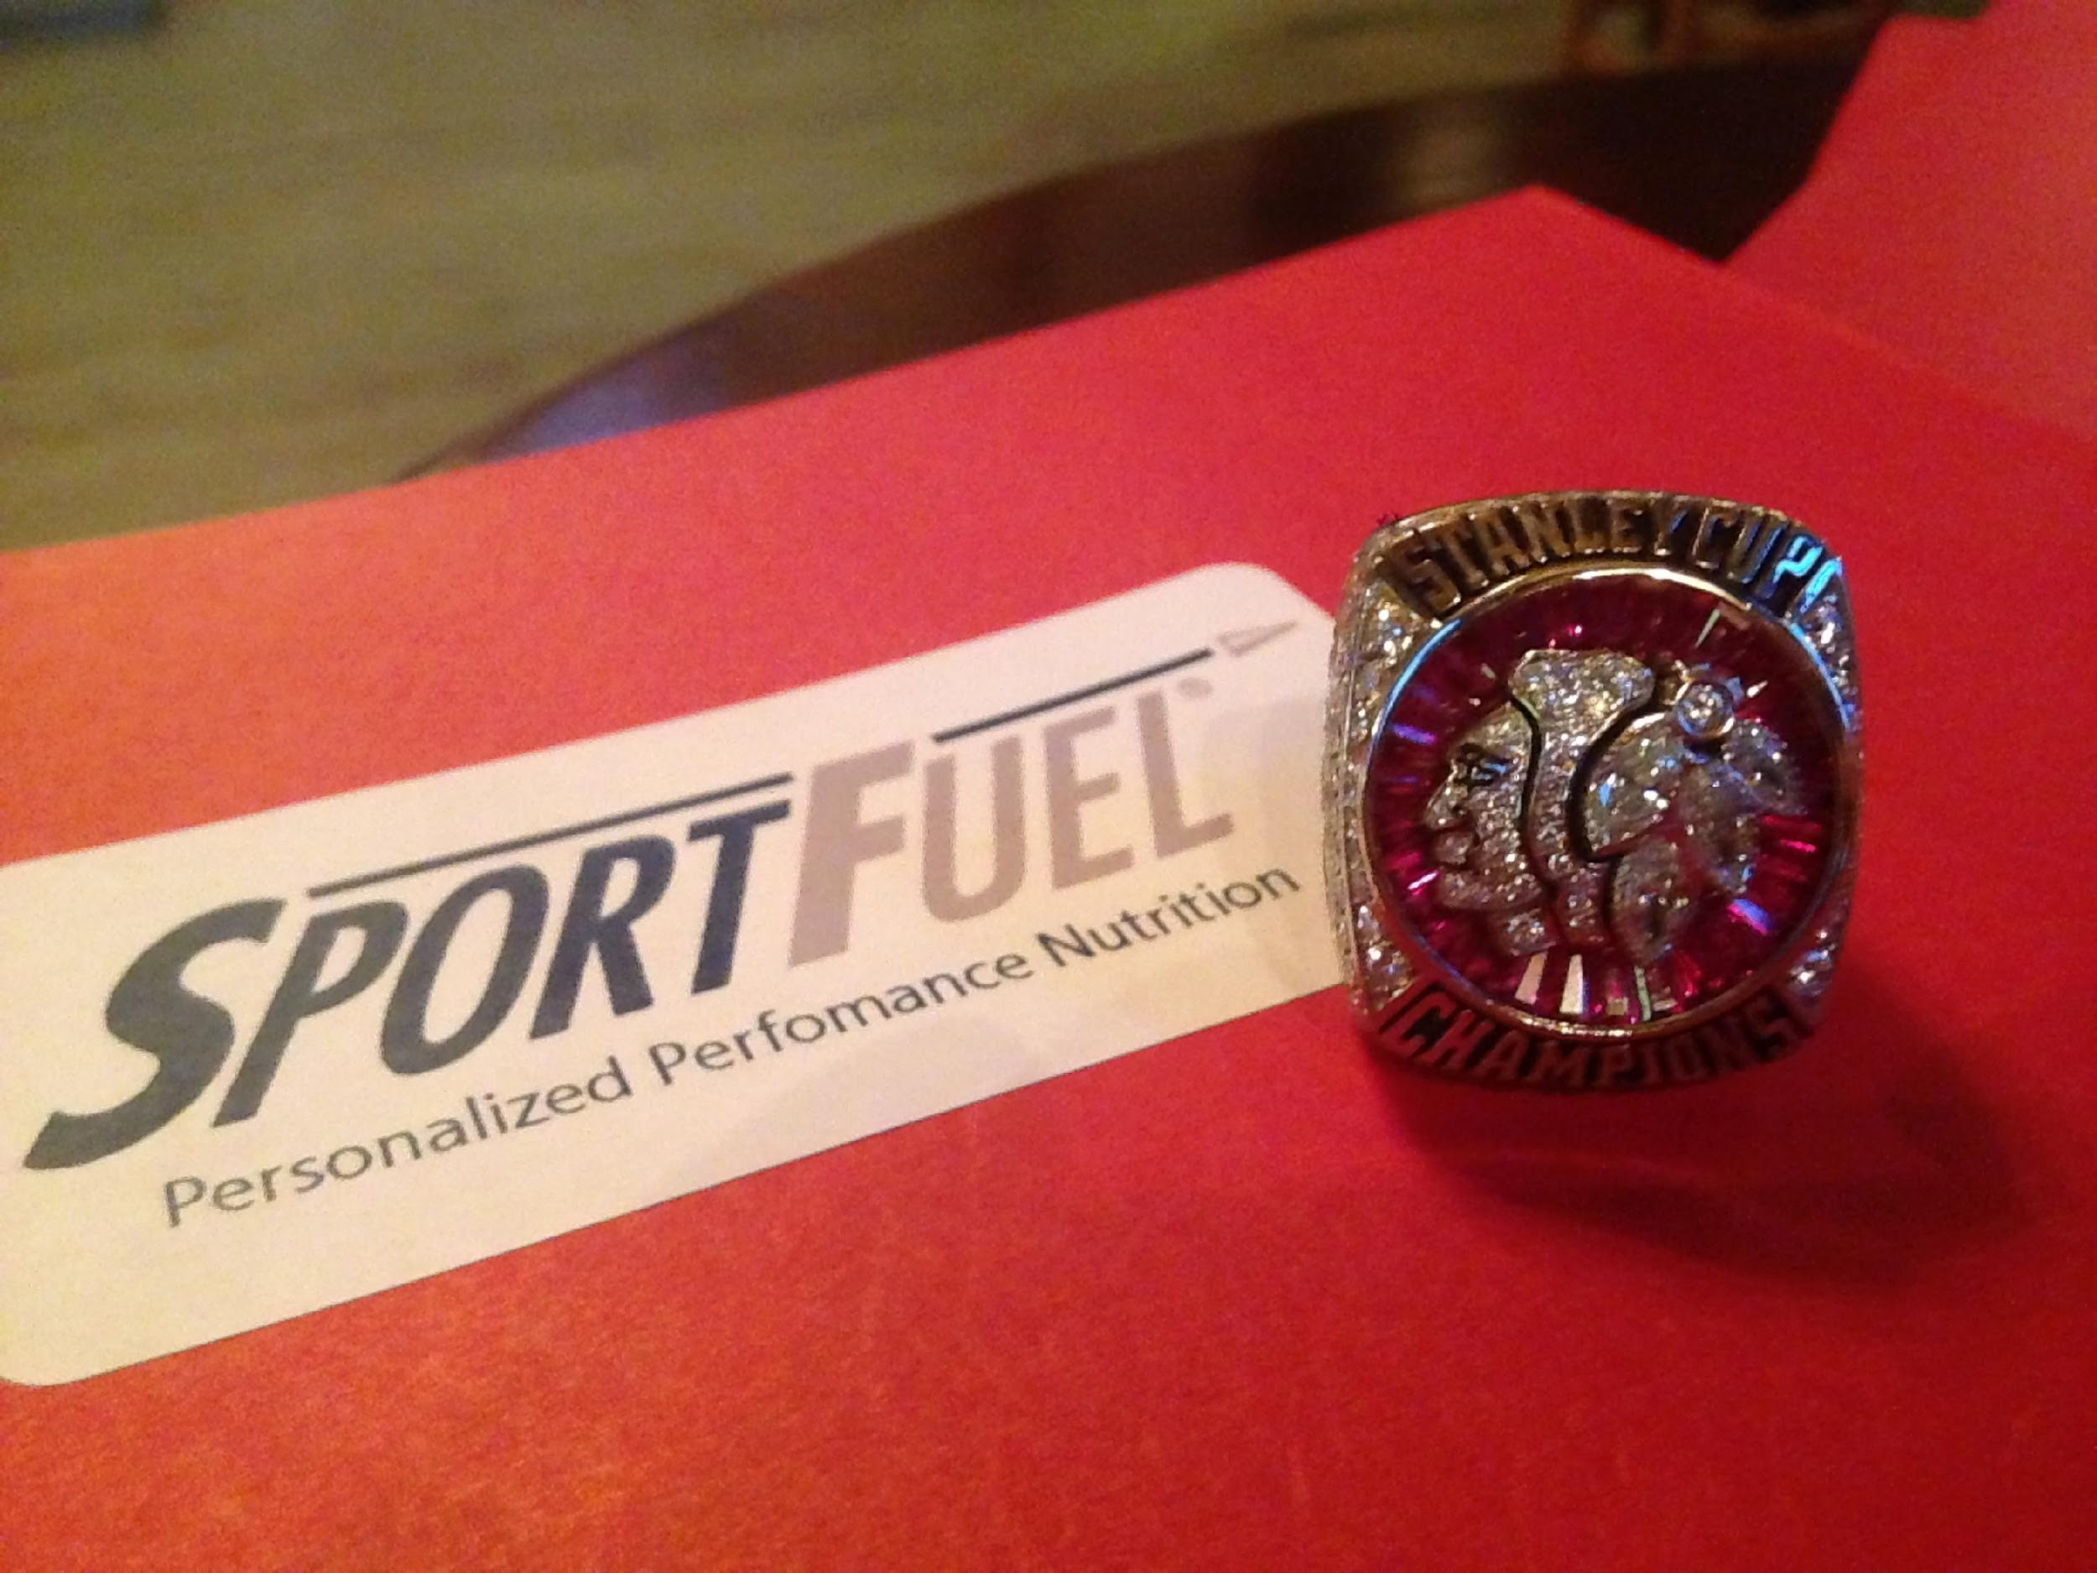
Questions?
Thank you!Questions?
© 2013 IHR, Inc., SportFuel, Inc.
Notes:
38
38

